Slide 1
Welcome

Slide 2
Teacher Introduce
Md. Alauddin
Headmaste
* Chorkol High School

Slide 3
Lesson introduce
Class-8 (Eight)
Subject-English 1st
Unit- 5 lesson 4
Time -40m.
Date:24.02.2019

Slide 4
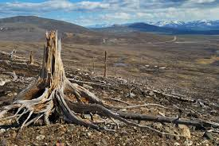
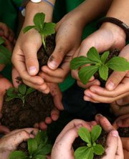
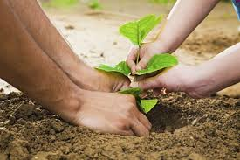
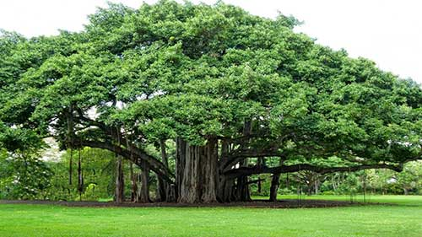
Let’s observe some photos with the role of trees
Treeless barren condition
Saplings with care handling
Being plantation
Shady & friendly banyan tree

Slide 5
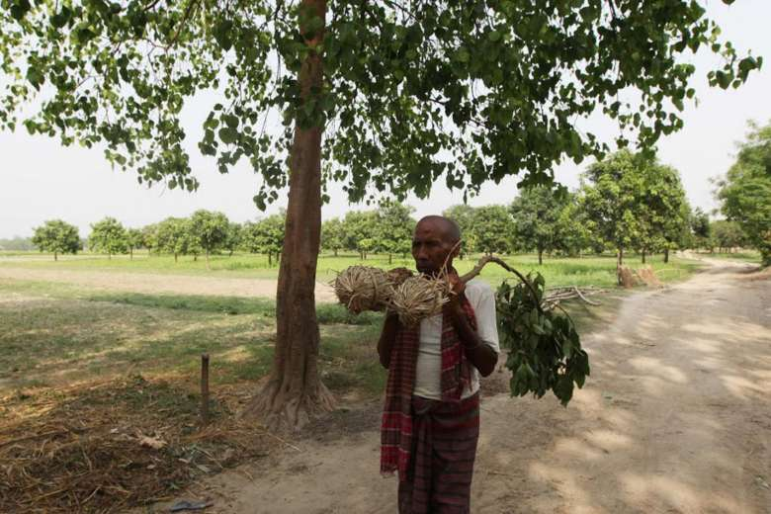

Slide 6
A man who loves trees.

Slide 7
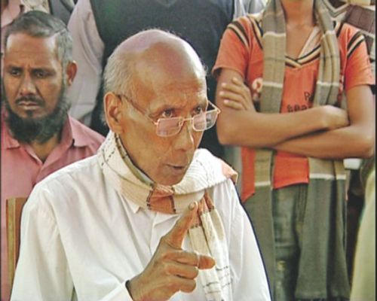
Kartik Poramanik

Slide 8
Lesson Outcomes
By the end of the lesson the students will be able to…
tell the profession of Kartik Poramanik
explain about his mission of planting trees.
analyse how a man can leave his sign in nature
evaluate the necessity of planting trees more.

Slide 9
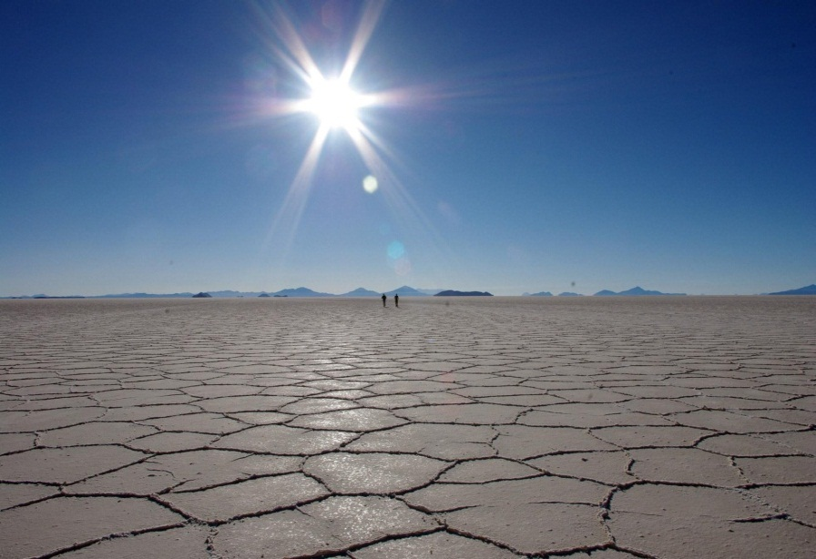
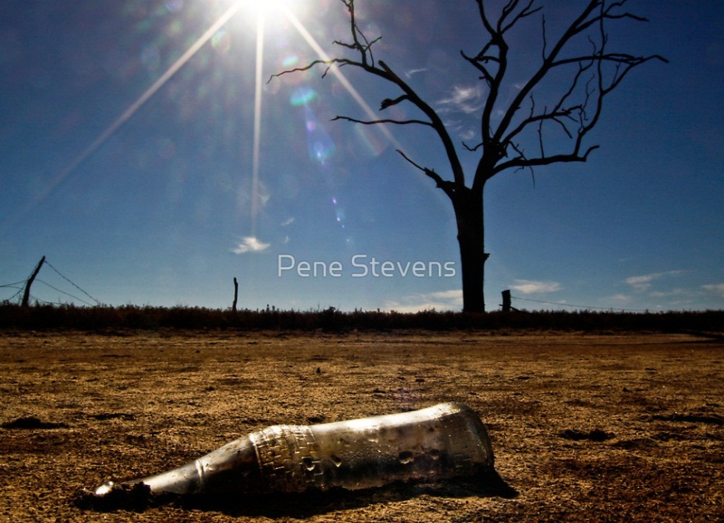
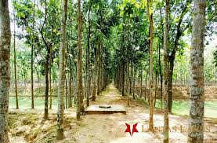
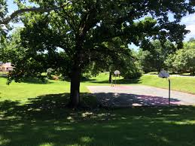
Let’s observe some images
I
Follow the treeless condition –(unhavitable land)
Treeful condition ( havitable land)

Slide 10
Let’s Learn the synopsis of the story of Kartik Pormank:
Kartic Pormanic lives in Tarapur in Thutapur Union under Chapainabavgonj .By profession he is a hair dresser. He has been greatly influenced by his father to plant trees as well as he himself also realized the need of trees .So he began to plant trees at the age of10.Now he is 63 . Till today about 20,000 trees have been planted by him in his village. Still he is continuing his mission of tree plantation. We wish him a long life.

Slide 11
NOW READ THE TEXT FOR FULL INFORMATION: The learners will read the text silently for 3 minutes in different groups and make their group opinion on the text.

Slide 12
The teacher will monitor and provide the students with words note , pronunciation and ensure their active involvement in group activities.

Slide 13
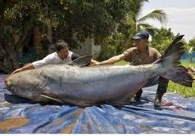
Let’s learn some new words
sapling
Young plants
a task or job that someone is given to do
mission
occupation
Profession or job
Very large in size
Gigantic
Strong desire for any thing
Passion

Slide 14
Let’s solve true /false questions:
If false give the correct information.
1 He planted the first tree 50 years ago
Ans.False: C.A-53 years ago
2 Kartik borrowed money from others to plant trees.
Ans.False CA-He would pay all the expenses from his own pocket.
3 He would plant trees around his hut only.
Ans. False CA- He planted trees every where on unused land of roads,schools,fields and many other places.
4At times Kartik would water his trees a night becaulse he felt lazy during the day.
Ans.False CA- He did his professonal work during the day and he was very active

Slide 15
Group work:
Discuss the following sentences in Groups and form your opinion.
G -A. “A man who can hardly sign his name, is leaving his signature all around in nature.”
G -B. Role of Trees for sustainable environment

Slide 16
Evaluation
Q1. What is the profession of Kartik Poramanik ?
Q 2 .Why did he begin to plant trees ?
Q3. Where did Kartik Poramanik plant trees ?
Q4. How do you understand that he is a nature lover
?

Slide 17
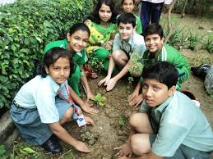
Home work :
Write your opinion on
“The necessity of Tree plantation “ in about 10 to 12 sentences.

